Slide 1
MERL: Multimodal Event Representation Learning in Heterogeneous Embedding Spaces
자연어처리팀: 박희수(발표자) 백지윤

Slide 2
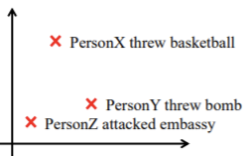
Event Representation Learning
Represent prototype events as low-dimensional dense vectors.
Use them as the basis to induce textual features for downstream applications, such as script event prediction and stock market prediction.
Notable progresses have been made in learning event representations or embeddings from structured event triples expressed as (subject, predicate, object)
(X, throw, basketball)
(Y, throw bomb)
(Z, attack embassy)

Slide 3
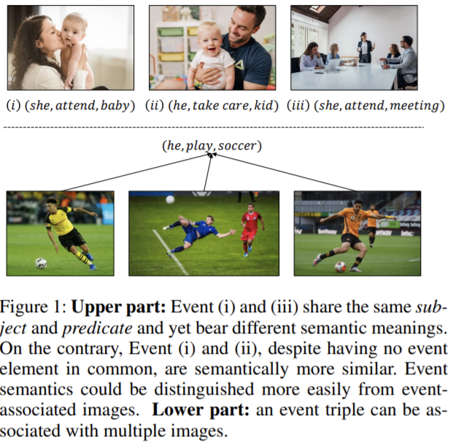
Motivation
Both Event (i) and (ii) share the same subject and predicate, however expressing totally different meanings.
Event (i) and (iii) do not have any event elements in common, yet they describe the same event

Slide 4
Motivation
Event semantics can be better captured by event-associated images rather than the text description of event triples
Previous approaches often project information from different modalities onto a homogeneous embedding space such as a point embedding space or a density embedding space (Vendrov et al. 2016; Ben and Andrew 2018).

Slide 5
Motivation
However, in event embedding learning, events depicted in images often convey much more information than their counterpart text descriptions.

Slide 6
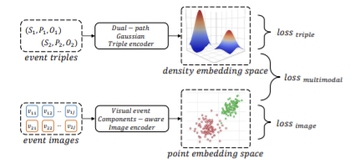
Motivation
Propose a multimodal event representation learning framework (MERL) to project event triples and their associated images onto heterogeneous embedding spaces.

Slide 7
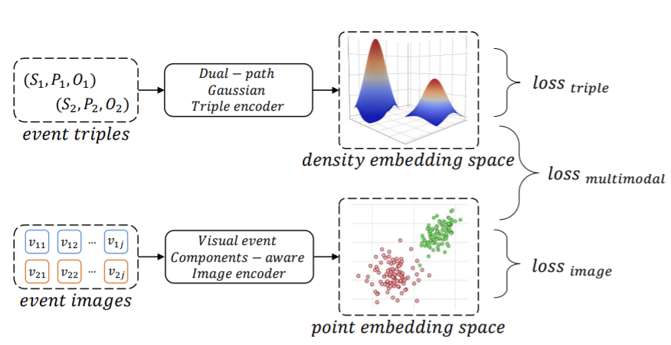
Multimodal Event Representation Learning on
Heterogeneous Embedding Spaces

Slide 8
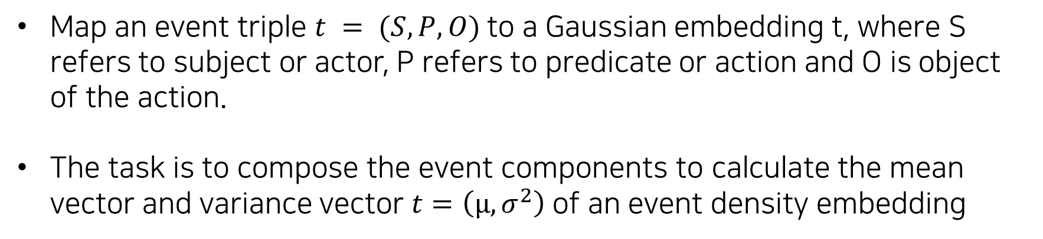
Dual-path Gaussian Triple Encoder
Map an event triple $t = (S, P, O)$to a Gaussian embedding t, where S refers to subject or actor, P refers to predicate or action and O is object of the action.
The task is to compose the event components to calculate the mean vector and variance vector $t=\left(µ, σ^{2}\right)$of an event density embedding

Slide 9
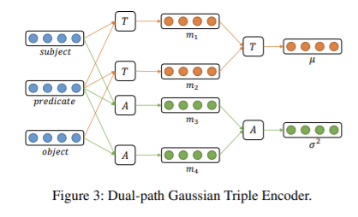
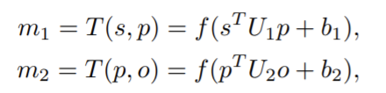

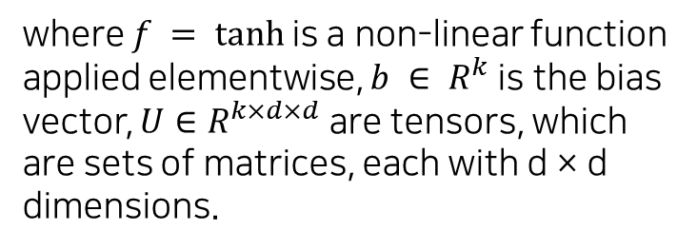
Dual-path Gaussian Triple Encoder
where $f = tanh⁡$is a non-linear function applied elementwise, $b ∈ R^{k}$is the bias vector, $U∈R^{k×d×d}$are tensors, which are sets of matrices, each with d × d dimensions.
For the event components comprising of multiple words, the average of their constituent word embeddings is applied.
Therefore, we introduce a tensor composition-based path to calculate the mean vector of an event Gaussian embedding.
µ is calculated by the tensor composition of the intermediate representations m1 and m2

Slide 10



Dual-path Gaussian Triple Encoder
where $W ∈ R^{k×2d}$is weight matrix.
For the variance vector, we assume that it mainly captures the variety of expressions relating to the same event, which is mainly determined by the predicates of events, not the multiplicative interactions between s and p or p and o.
Thus introduce an additive-composition-based path to model the variance vector of an event Gaussian embedding.
The variance vector σ 2 is calculated by the additive composition of the intermediate representations m3 and m4:

Slide 11
Visual Event Components-aware Image Encoder
Map an event image v to a point embedding v, where the image embeddings of similar triples should be clustered and image embeddings of dissimilar triples should be separated.
To capture the event semantics in the image, we proposed to detect visual event components in the image and compose their representations to get event image embedding.

Slide 12
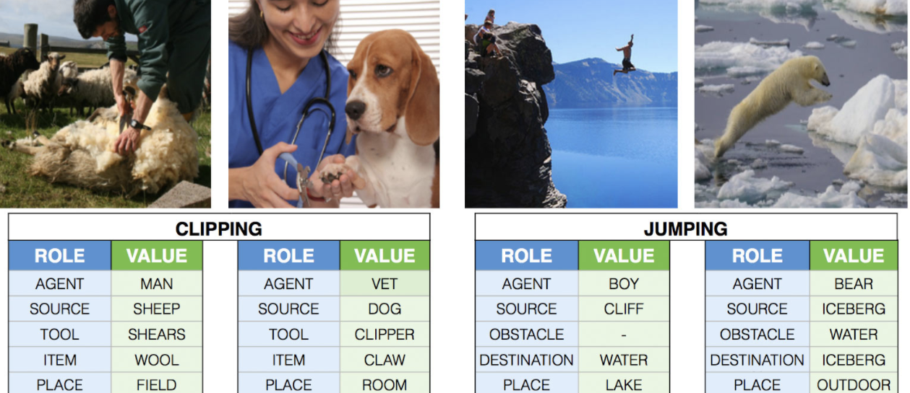
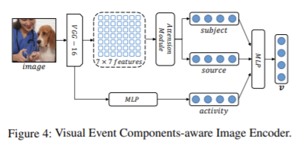
Visual Event Components-aware Image Encoder
First train an image classifier on the ImSitu dataset, which introduces the task of situation recognition (In ImSitu, every image is annotated with an activity and roles (called attributes) which are participants in the activity)
Pre-train the image encoder to identify three attributes in ImSitu, subject, activity and source, which are corresponding to subject, predicate and object in an event triple.

Slide 13



Visual Event Components-aware Image Encoder
Employ the attention mechanism to extract open-vocabulary event components.
A VGG-16 CNN to extract an overall image feature g and a 7 × 7 convolutional feature map for each image v: ki,j = CNN(v), which can be regarded as attention keys for 7× 7 local regions

Slide 14
Visual Event Components-aware Image Encoder
The representation of activity (predicate) is obtained by feeding the overall image feature g into an MLP: rp = MLP(g)
In the pre-training stage, we feed the extracted representations of subject and source as well as the representation g of the whole image I into the classification layers to perform situation recognition task.

Slide 15

Visual Event Components-aware Image Encoder
After pre-training, we replace the classification layer with a fully-connected layer to compose the representations of event arguments and obtain the final representation of an image ei

Slide 16
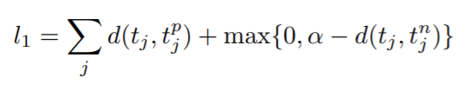


Training
For the intra-triple loss, we introduce a max-margin loss to encourage similar events having higher similarity score than the negative pairs.
The similarity score is measured by the Bhattacharyya distance between two distributions:

Slide 17


Training
For the intra-image loss, the objective function encourage the encoder persevere the semantic relationships of event images in the embeddings space
The last loss is to align the results produced by the two encoders, so that the knowledge from two modalities could be utilized to mutually enhance the event density embeddings and image embeddings learned

Slide 18
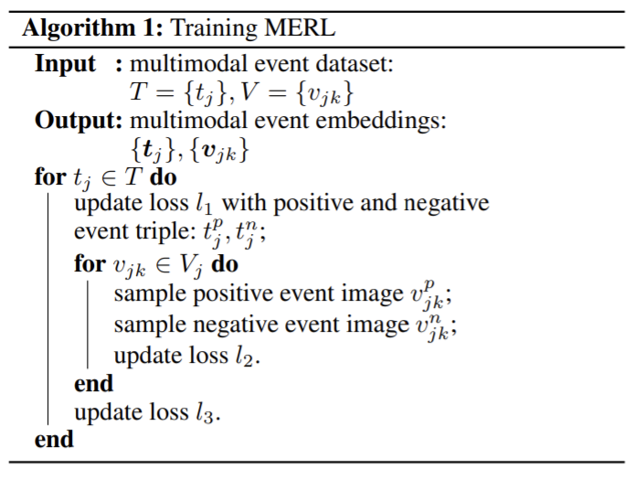
Training

Slide 19
dataset
The original dataset: 1,000 event triples, each event is paired with a positive sample and negative sample.
The positive sample: e.g., police catch robber / authorities apprehend suspect
The negative sample: e.g., police catch robber / police catch disease
The extended dataset: each event triple is used to query Google Image to retrieve 20 candidate images, which are filtered by human annotators to keep the top 10 most relevant ones.
Final multimodal event similarity dataset consists of 3,000 event triples paired with 30,000 event images.

Slide 20
Experiments - Multimodal Event Similarity
Multimodal hard similarity dataset:
Extended Weber et al. (2018)
230 pairs of events (115 pairs of similar types and 115 pairs of dissimilar types). → 690 event triples paired with 6,900 event images.
Transitive sentence similarity dataset:
(Kartsaklis et al., 2014),
108 pairs of transitive sentences (i.e. short sentences contain a single subject, verb and object).

Slide 21
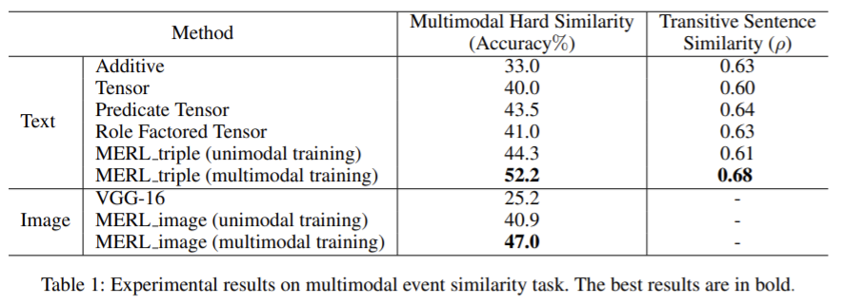
Experiments - Multimodal Event Similarity
Results From the results in Table 1 we can observe that after multimodal training, our triple encoder and image encoder both outperform other baselines and the variant of MERL trained with unimodal data only. This verifies our hypothesis that leveraging knowledge from both modalities enhances the quality of event embeddings learned in each modality.

Slide 22
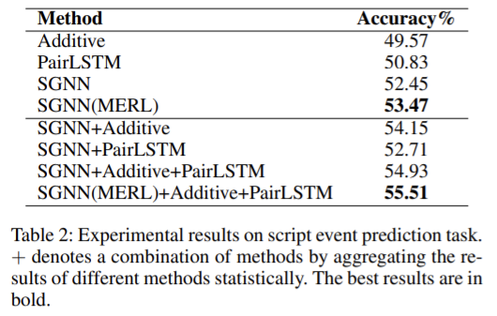
Experiments- Script Event Prediction
Multiple choice narrative cloze dataset
Li, Ding, and Liu (2018) The dataset contains 140k samples for training and 10k samples for testing. For each event chain, 5 candidate events are provided with 1 correct answer.

Slide 23
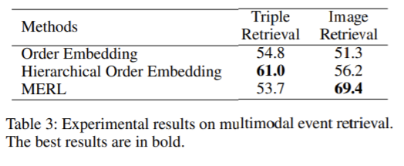
Experiments -Cross-modal Event Retrieval
the multimodal hard similarly dataset

